Slide 1

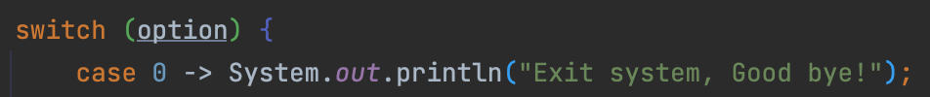
Take Flight Airways
Your exits are here
CLI GROUP 4 - Michelle Tambi, Peace Akib, Lewis Broadhurst, James Stillman

Slide 2
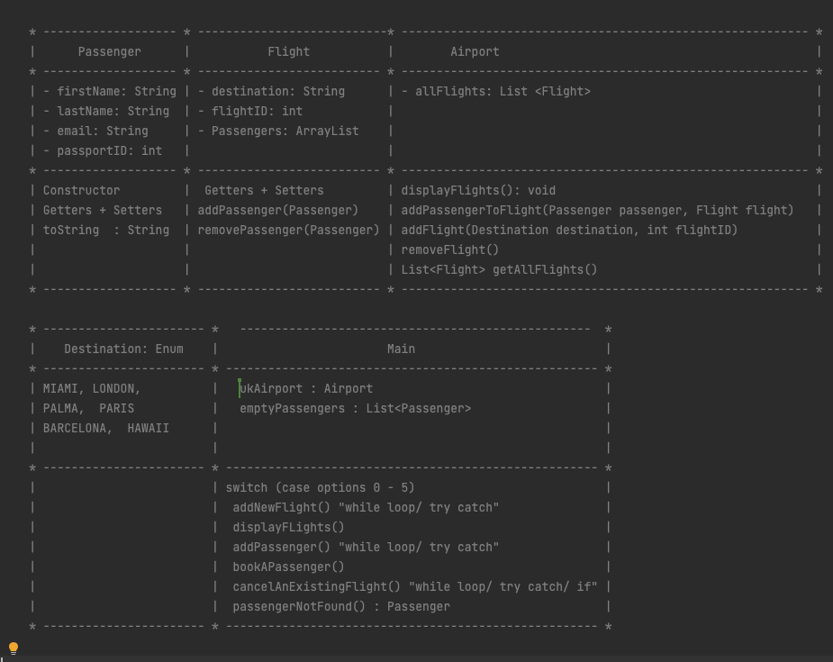
UML

Slide 3
Positives
- Great stream of communication
-UML diagram plan
-Learnt new concepts such as sout output testing
-Getting more exposure to while loops & Switch/Case statements

Slide 4
Improvements
- Sharing code was challenging at times
-Adding exceptions
-Testing with scanner inputs
-Adding save functionality

Slide 5
https://github.com/JStillman1/CLI_Lab
Thanks for Listening!
Any questions or feedback?

